Slide 1
Software Product Management Business models (How is revenue generated?)
Nandagopal Govindan

Slide 2
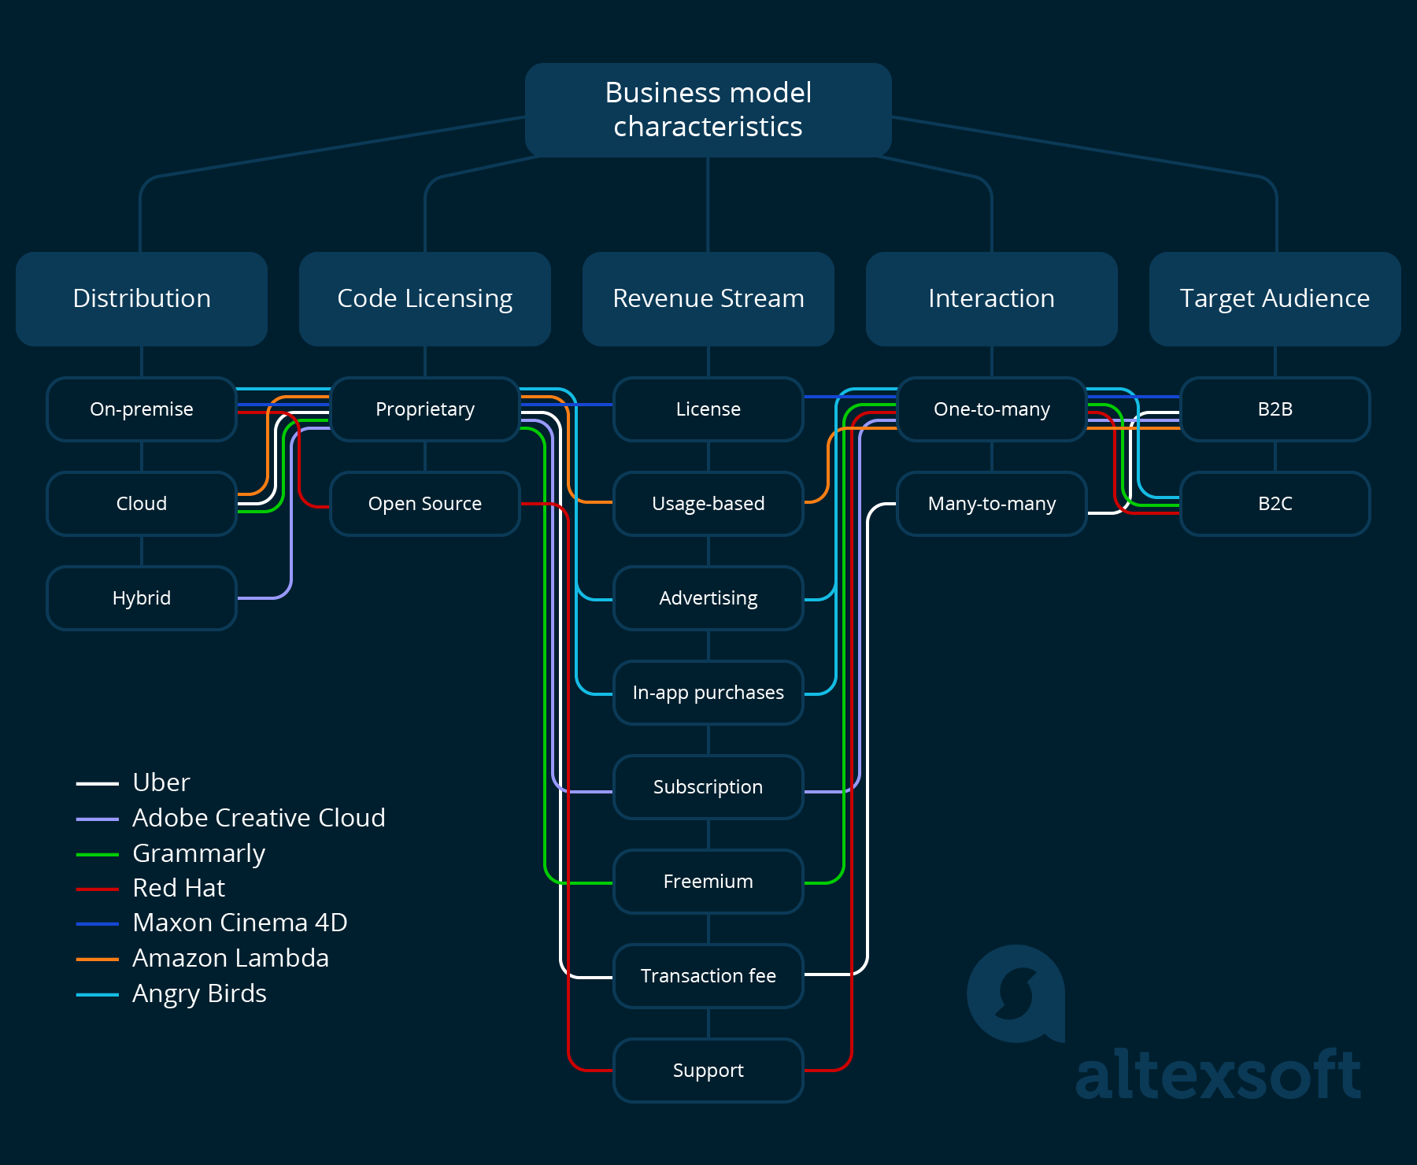
Ref: altexsoft.com

Slide 3
Revenue streams
Type | Description / Example
Licenses | One-time upfront license fee + fee for upgrades and support
Subscriptions | Salesforce, Financial Times, Spotify
Usage based | AWS, AWS Lamda, MailChimp, ShutterStock.
Freemium | Free & Premium versions: Grammarly, Tinder, Zapier
Transaction fee | AirBnB, Uber, eBay, Payment Gateway
Advertising | Google Search, Angry Birds, Facebook, Twitter. Google
In-app purchase | VSCO, Meet Me
App store | Commission on app sold: SAP EcoHuub, Microsoft solution finder
IP licensing | Google leasing Chrome browser & Android OS for purpose built device

Slide 4
Exercise
What revenue stream model would do you recommend for this product business and why?
Online children stories
Online library of BE student books
Product recommendation & consulting business

